Slide 1
Argumentation Skills
Principles and Devices

Slide 2
Argumentation Skills
Argumentation is the thought process used to develop and present arguments.
It is closely related to critical thinking and reasoning.
An essential 21st century cognitive skills.
The term argument refers to "a reasoned attempt to convince the audience to accept a particular point of view about a debatable topic.“
“An argument is constituted by two or more explicit and/or implicit claims, one or more of which supports or provides evidence for the truth or merit of another claim, the conclusion.” (T. Edward Damer)

Slide 3
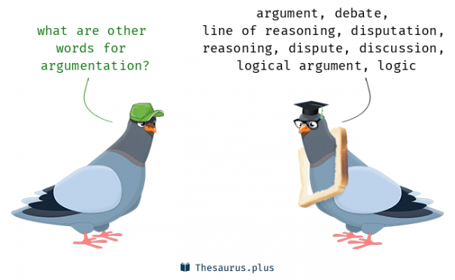
Characteristics
An argument consists of a conclusion and one or more premises, or claims.
Not irrational
Does not depend strictly on passion or emotion
Represents a "reasoned attempt"
Based on careful thinking and planning
Appeal is to the mind, the intellect of the
audience.

Slide 4
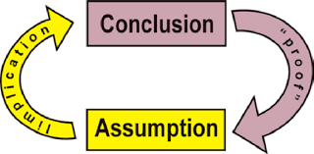
Principles
The five principles for developing a good argument:
Structure
Relevance
Acceptability
Sufficiency
Rebuttal

Slide 5
1. Structure
A good argument must meet the fundamental structural requirements of a well-formed argument.
To evaluate any argument for whether it violates the principle of Structure, ask the following questions:
Does the communication include at least one reason to support the conclusion as being true? If it doesn’t, then it’s not an argument — it’s merely an opinion.
Could any of the key premises be interpreted as making the same claim as the conclusion? If so, then it’s a “circular argument”. “Joe is nuts,” Gary says. “Why do you say that?” I ask. “Because he’s so crazy,” Gary replies. Since A, therefore A.
Do any of the premises contradict another premise, or does the conclusion contradict any of the premises?

Slide 6
2. Relevance
The reasons that a communicator provides as part of his or her argument must be relevant for the truth or merit of the conclusion.
To assess whether an argument violates the principle of Relevance, ask these two questions:
If the premise were true, does it make you more likely to believe that the conclusion is true? If yes, the premise is probably relevant. If no, then the premise is probably not relevant.
Even if the premise were true, should it be a consideration for accepting the truth of the conclusion? If no, then the premise is probably not relevant. “Jerry is over 6 ft. tall. So he must be good at basketball.” “Avatar is an artistic masterpiece. After all, it was the highest grossing film of the year.”

Slide 7
3. Acceptability
A premise should be acceptable to a mature, rational adult.
To assess whether an argument violates the principle of Acceptability, ask the following questions:
Is the premise provided one that a mature, rational adult would likely accept?
What evidence is provided as part of the claim, and does it conform to the standards of acceptability or the conditions of unacceptability?
Is the premise based on an unstated assumption that a mature, rational adult not be willing to accept?

Slide 8
4. Sufficiency
A communicator making an argument should provide reasons that are sufficient to justify the acceptance of his or her conclusion.
To evaluate whether an argument violates the principle of Sufficiency, ask the following questions:
Are the reasons provided enough to drive to the arguer’s conclusion?
Is the premise based on insufficient evidence or faulty causal analysis? Some premises provide evidence that is based on too small a sample or unrepresentative data. Or the evidence is based on the personal experience of the arguer, or of a small set of acquaintances that the arguer knows. The premise may be based on faulty causal analysis — assuming A caused B, even though the two events were unrelated.
Is some key or crucial evidence missing that must be provided in order to accept the argument?

Slide 9
5. Rebuttal
A good argument includes an effective rebuttal to all anticipated serious criticisms of the argument.
To assess whether an argument fails to meet the Rebuttal principle, ask the following questions:
Does the argument provided address the strongest counterarguments effectively?
Does the arguer anticipate and address serious weaknesses in the argument?
Does the argument show why alternative positions are flawed?

Slide 10
Suggestions for Stronger Argument
Structure: Explicitly call out your conclusion and the supporting reasons, so that they are easy to recognize and follow.
Make explicit any key assumptions that you’re using.
Ensure that your premises
(1) do not contradict each other or the conclusion
(2) do not assume the truth of the conclusion.
Relevance: Ensure that all materials you’re presenting as part of your argument are relevant. Don’t weaken your argument by including irrelevant premises.

Slide 11
Suggestions for Stronger Argument…..contd.
Acceptability: Whenever possible, substitute less controversial claims for more controversial ones.
Soften, if possible, any absolute claims to make them more acceptable. (e.g. “most politicians” instead of “all politicians”)
Don’t use highly questionable evidence or assumptions.
Sufficiency: Continue adding relevant premises if they contribute to the number and weight of the reasons that drive to your conclusion.
Put yourself in your audience’s place, and ask if the reasons are sufficient to accept your conclusion.

Slide 12

Suggestions for Stronger Argument…contd.
Rebuttal: Be as exhaustive as necessary in your rebuttal.
Some arguments may need to rebut a single criticism, but more controversial or divisive issues may require multiple rebuttals.
Declare up front what the weakest parts of your argument are and proactively address them to blunt the force of your opponent’s counterarguments.

Slide 13

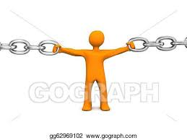
Devices of Argumentation
Analysis – Analyse the argument.
Check for evidences, conclusions & assumptions.
Cohesion – A series of logical reasons to support an idea.
Start by showing research and giving context for the issue.
Tools of Cohesion –
Use of pronouns
Repetition of key words or phrases
Use of transitional tags
Use of parallel grammatical structure

Slide 14
Devices of Argumentation……..contd.
Emphasis –
Emphasize on key idea.
Repeat key points throughout the premises to establish connect.
Critical Thinking –
Analyse facts to form judgement.
Rational, sceptical, unbiased analysis of factual evidence.
Nuances/ Organisation of Content -
Introduction, Body & Close

Slide 15
THANKS

